Slide 1
Practice Lab:
This Practice Lab is dependent on Discussion Module 7455, where most of the objects we create in this lab were introduced.
This Practice Lab requires a working DSE system, with DSE Search enabled, and with ability to execute CQL DDL.
All commands are run from CQLSH, or DSE Studio. CQLSH is required to COPY data into (a table).
DSE Search, Spatial, Time Series
Notes:
The goal of this Practice Lab is to create a resource planner; Which employees are scheduled to be working right now ?
Runtime requirements are detailed in the slide above.

Slide 2
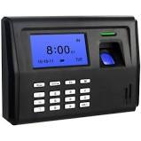
Challenge 1: Who is on the clock ?
In Module 7455 we modeled days, and queried an intersection (query 2); which records intersect a range.
Create the model, data, and serve the query; Which employees are scheduled to be on site at 8 AM ?
Offer a precision of one minute.
Use whole numbers; don’t introduce the complexity of timestamps.
Notes:
Design and deliver the runtime statements and query to deliver the above-

Slide 3
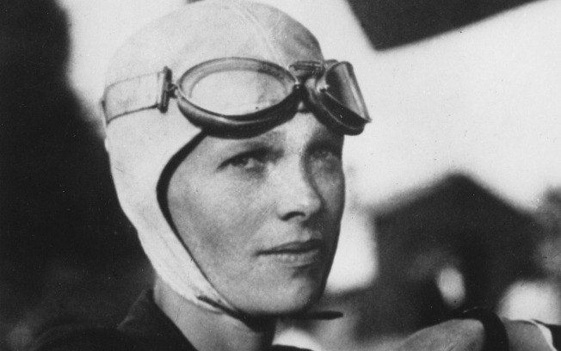
Go Farther: (Optional)
Amelia Earhart was only the 16th woman in the entire world to be given a pilot’s license. She became famous in 1928 when she became the first woman to fly across the entire Atlantic Ocean, but she was also famous for being the first person to fly over both the Pacific and Atlantic Ocean as well.
http://famous-explorers.org/top-10-famous-expeditions/
Notes:
Go farther in this Practice Lab: given sample syntax, build something new.

Slide 4
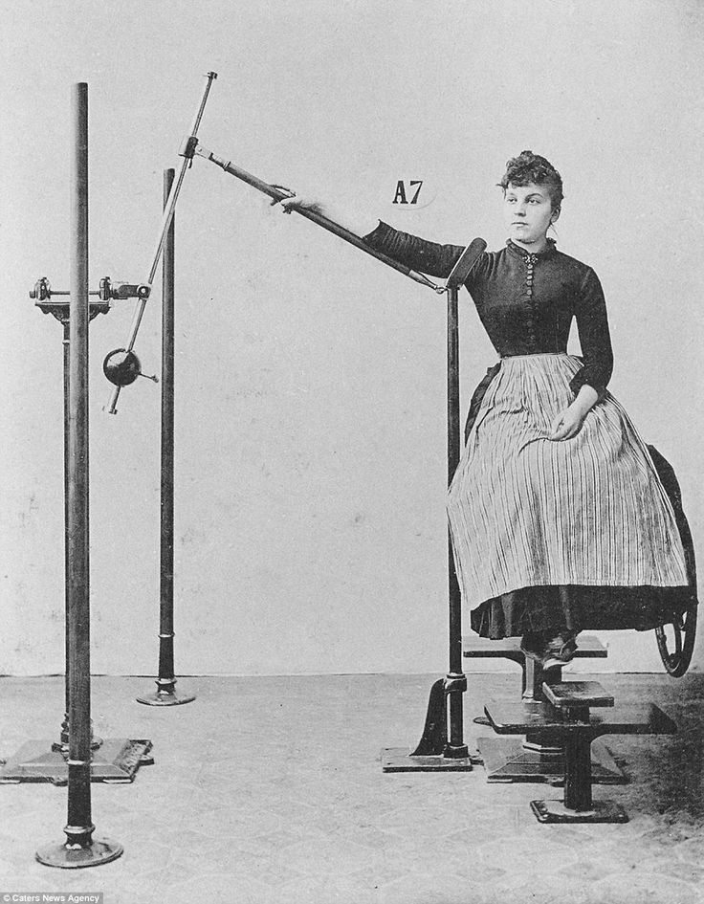
Challenge 2 (Optional): Second Column for Date
Extend (Copy) Challenge 1-
Use a new table.
Add a second whole integer column for date.
Write the query to support time and date.

Slide 5

Practice Lab:
Lessons Learned
Notes:
Discuss what worked well, poorly, from the Practice Lab.

Slide 6
End of Module:
Notes:
End of Practice Lab-

